Slide 1
IS Mini Project
Presented By:
1] Shubham Doke (2019BCS155)
2] Kushal Dayama (2019BCS139)
3] Pravin Kulkarni (2019BCS141)
4] Shivendra Bhaganagre (2019BCS135)

Slide 2
SQL Injection, Cross Site Scripting and Their Preventions
Abstract 3
Introduction 4
Design of Study 5
Create a Web Application 6
SQL Injection Attack 14
SQL Injection Prevention 18
Cross Site Scripting(XSS) 22
Cross Site Scripting Prevention 29
Summary and Github Link 32

Slide 3

Abstract:
Many website companies or organisations face an issue of SQL injection attack and also the cross site scripting.
By these 2 methods the attacker can hack and get the confidential information about the organisation and he can do many things which are prohibited for the external people.
So, we need to prevent so that our confidential information will be secured and not go in wrong hands.

Slide 4
Introduction:
SQL injection has been a serious problem faced by all the websites. As per web application attack statistics, about 24.9% of attacks were SQL injection ("Web Application Attack Statistics", n.d., 2017). Cryptography is one of the dominant techniques to prevent SQL injection attacks. All the confidential data are encrypted and stored in the database; even if the hacker gains access to the database, he/she cannot be able to decrypt the data without the knowledge of algorithm and key used to encrypt the data. Providing security to the database is the essential part of running an online business. Database security requires permitting or prohibiting user action on the database and the objects on it.
Cross-Site Scripting (XSS) is a misnomer. The name originated from early versions of the attack where stealing data cross-site was the primary focus. Since then, it has extended to include injection of basically any content, but we still refer to this as XSS. XSS is serious and can lead to account impersonation, observing user behavior, loading external content, stealing sensitive data, and more. We have prevented both SQL injection and cross site scripting by cryptography and output encoding simultaneously.

Slide 5
Design of Implementation:
Design involves the following steps:
Create a web application.
Conduct all the major SQL Injection Attack on the web application.
Implement the cryptographic algorithms on the web application to prevent it.
Try SQL Injection Attack after implementation.
Record the response of the web application.
Conduct all the major Cross Site Scripting Attack(XSS) on the web application.
Implement the output encoding algorithms on the web application to prevent it.
Try XSS Attack after implementation.
Record the response of the web application.

Slide 6
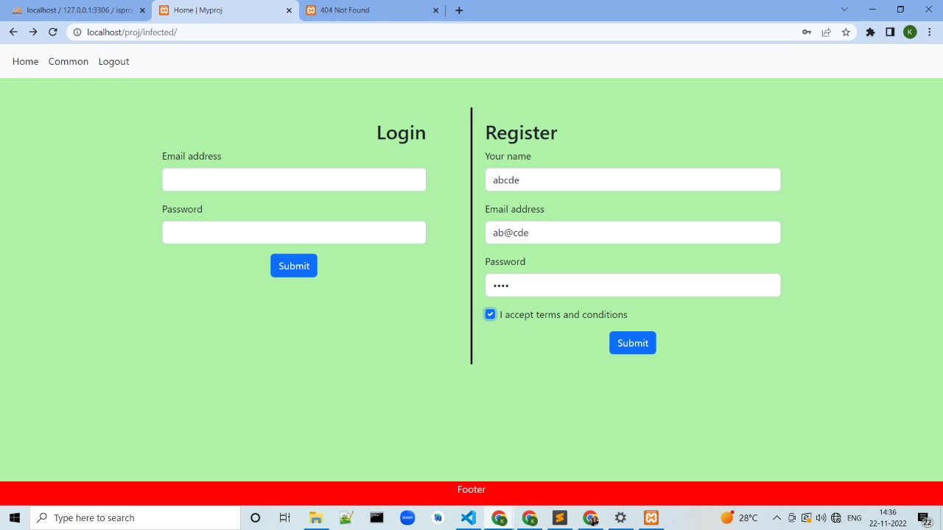
Create a web application:
Creating new user using register form

Slide 7
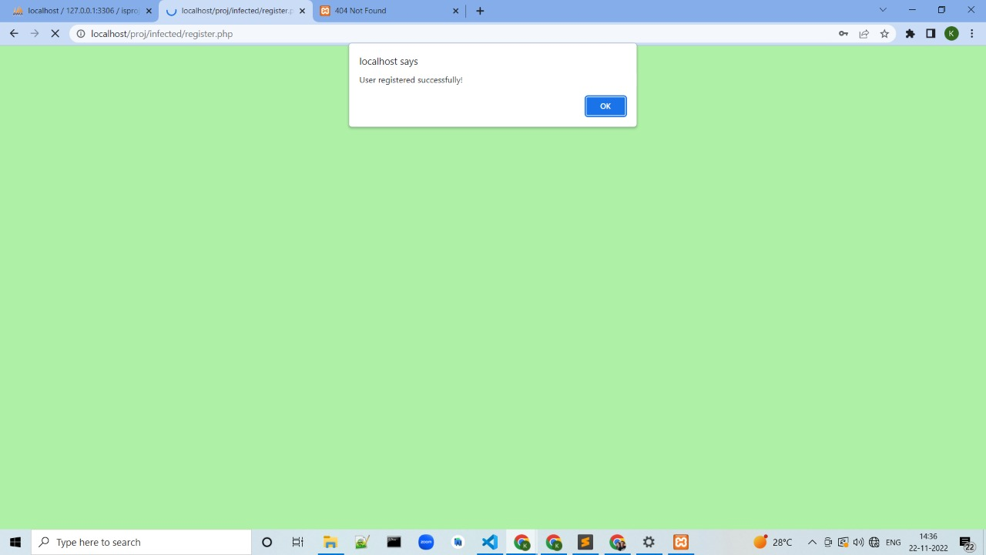
Create a web application:
User registered successfully

Slide 8
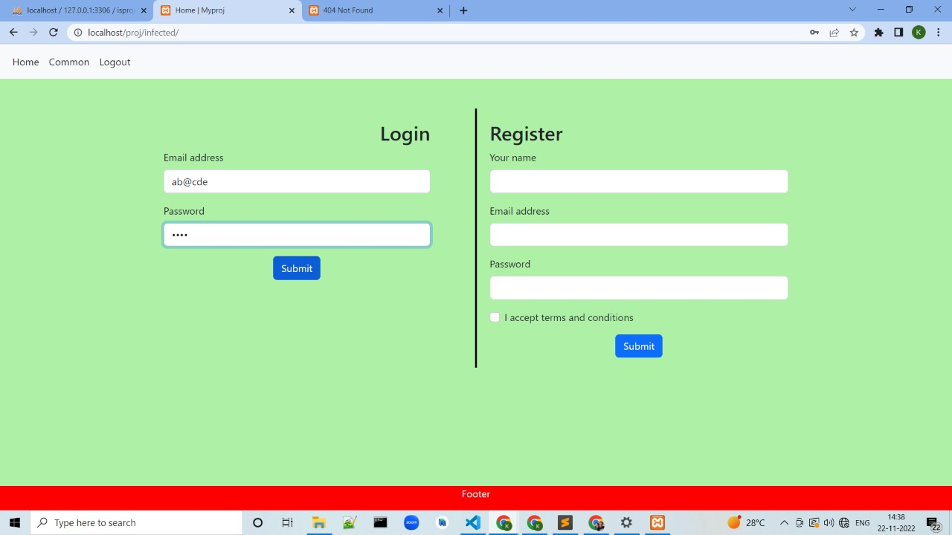
Create a web application:
Logging inside the web application for authenticated user.

Slide 9
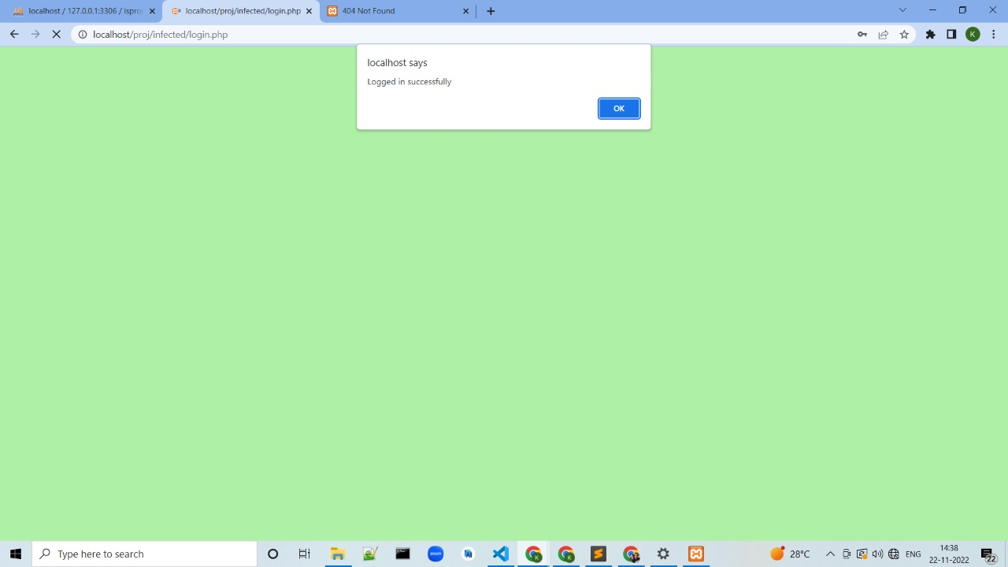
Create a web application:
Authenticated user logged in successfully.

Slide 10
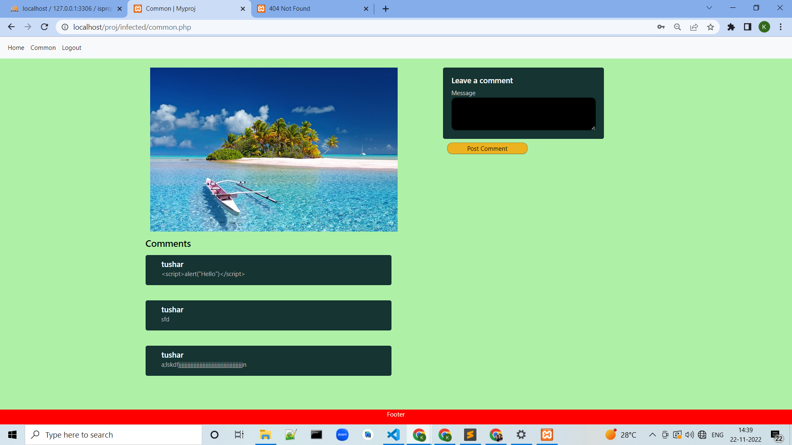
Create a web application:
Showing the home page of site where the user can see the comments made on the picture by different-different people.

Slide 11
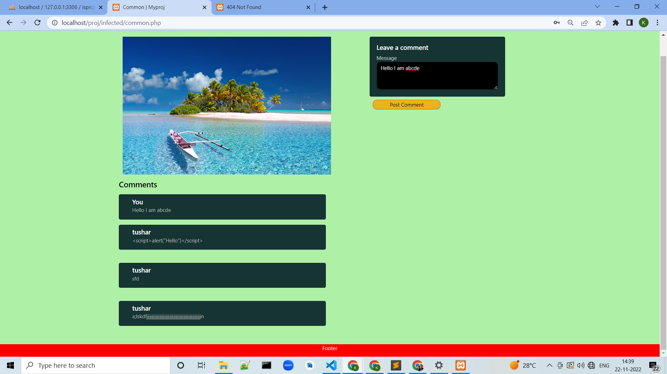
Create a web application:
Adding a new comment by authenticated user

Slide 12
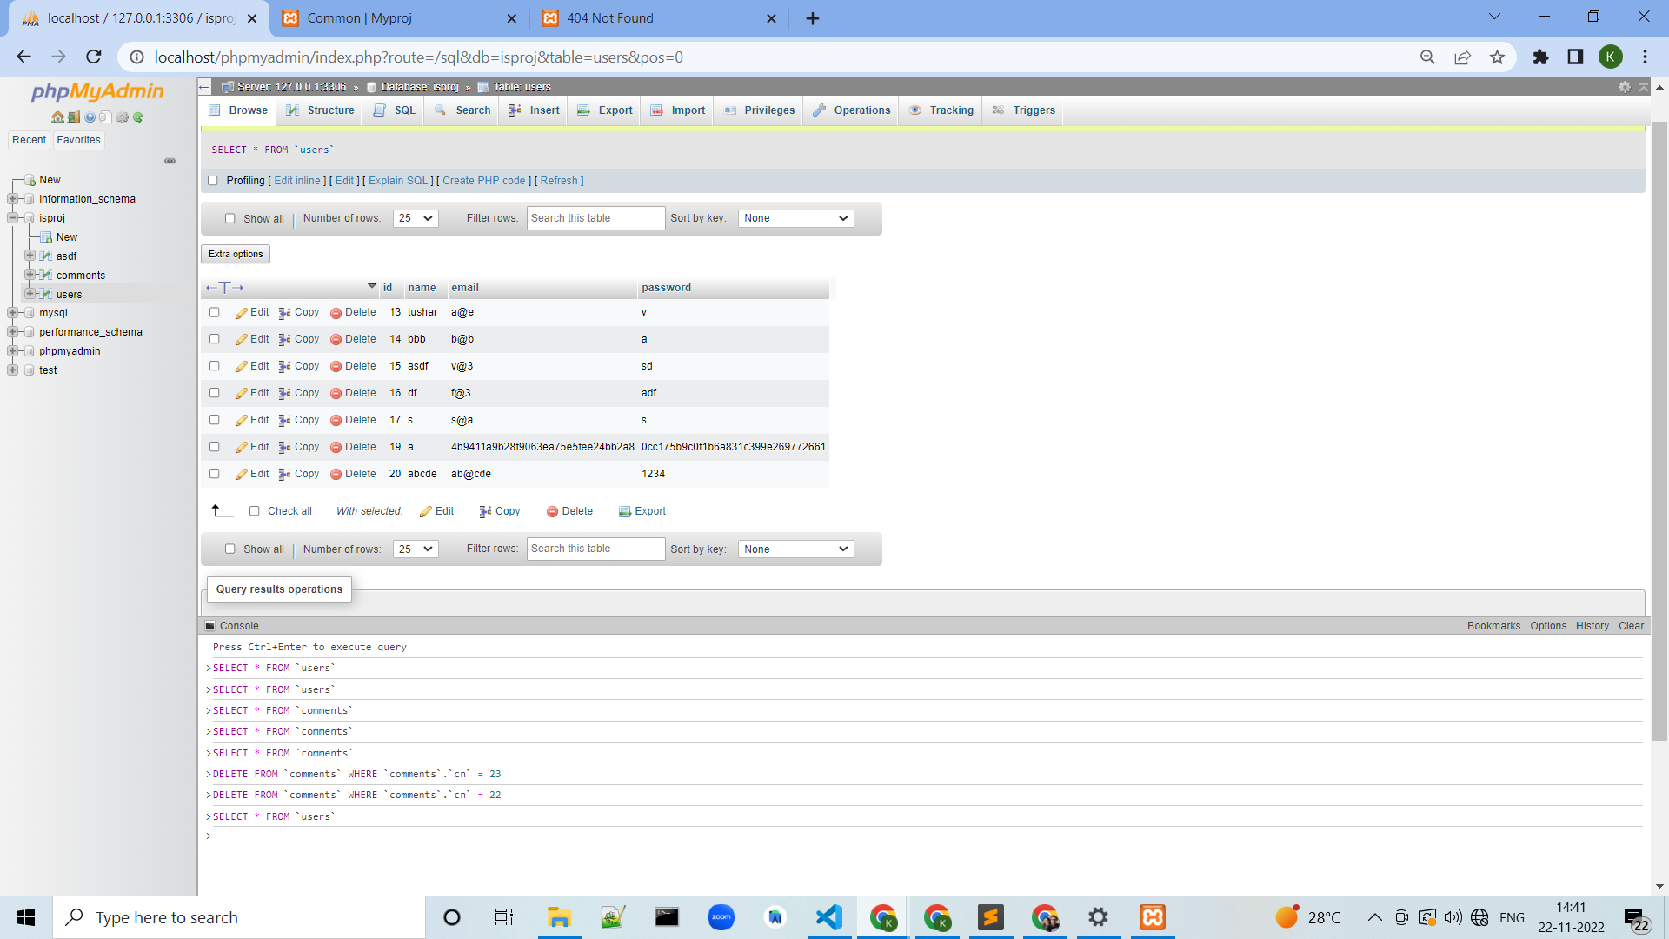
Create a web application:
Showing the users table which has the details of authenticated users.

Slide 13
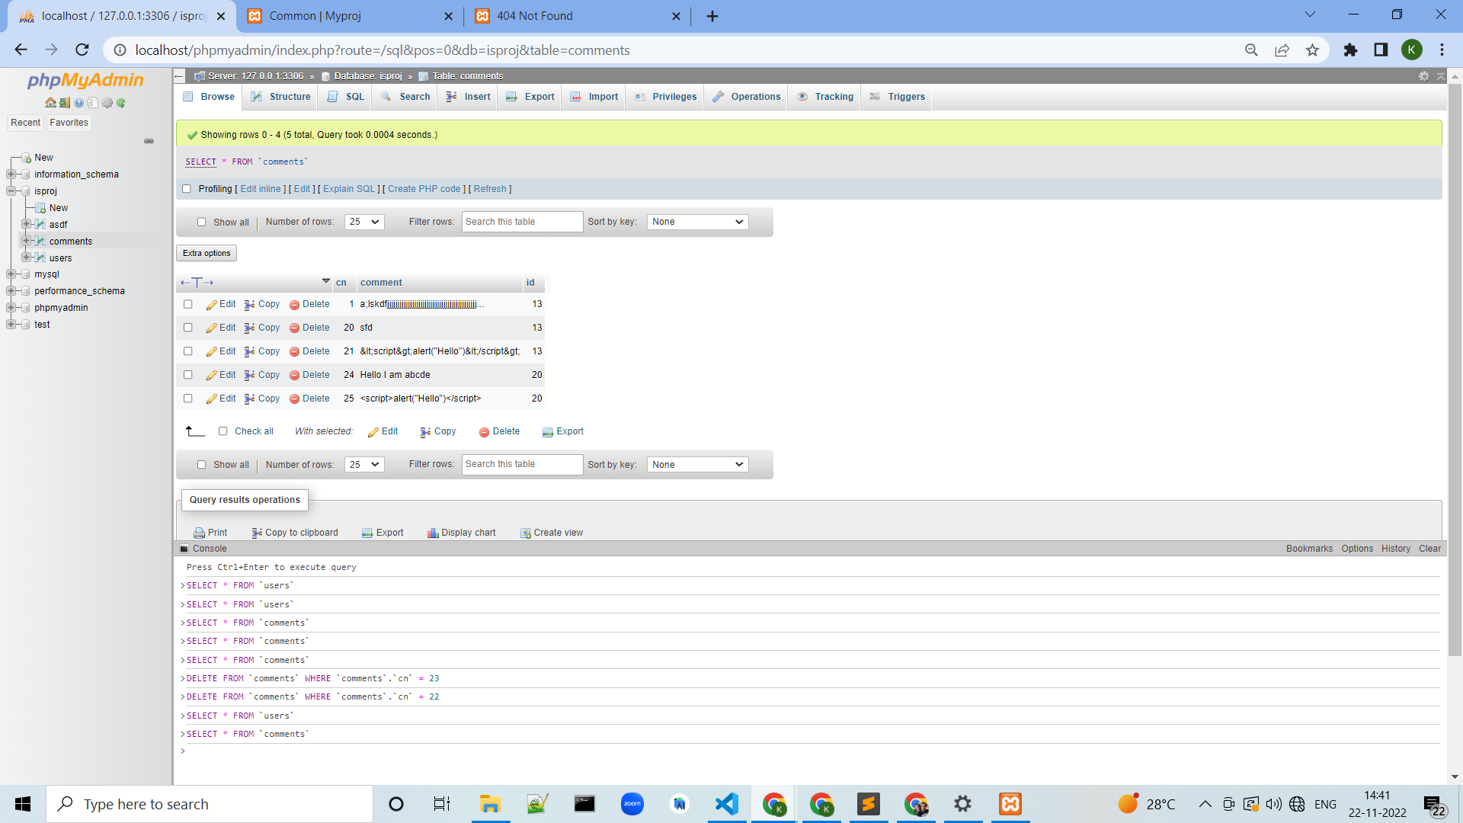
Create a web application:
Showing the comments table which has the details of comments.

Slide 14
SQL Injection Attack:
SQL Injection is an attack that employs malicious SQL code to manipulate backend databases in order to obtain information that was not intended to be shown, The data may include sensitive corporate data, user lists, or confidential consumer details. An attacker who knows the correct syntax for injecting SQL commands into an application’s back end could use this to execute unauthorized or destructive actions on behalf of the target user. An ethical hacker should always test for and identify potential SQL injection vulnerabilities, as they are one of the most frequently used attacks in today’s digital world.
SQL injection is a code injection technique that might destroy your database.
SQL injection is one of the most common web hacking techniques.
SQL injection is the placement of malicious code in SQL statements, via web page input.

Slide 15
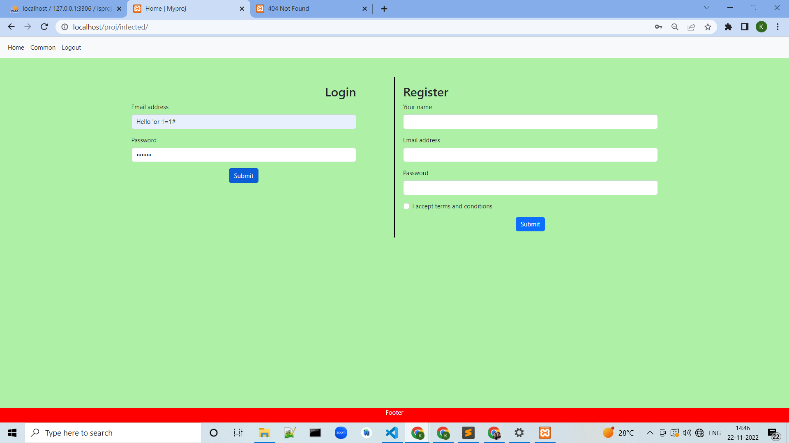
SQL Injection Attack:
Malicious user trying to login into website with SQL Injection method

Slide 16

SQL Injection Attack:
Malicious user logged in successfully.

Slide 17
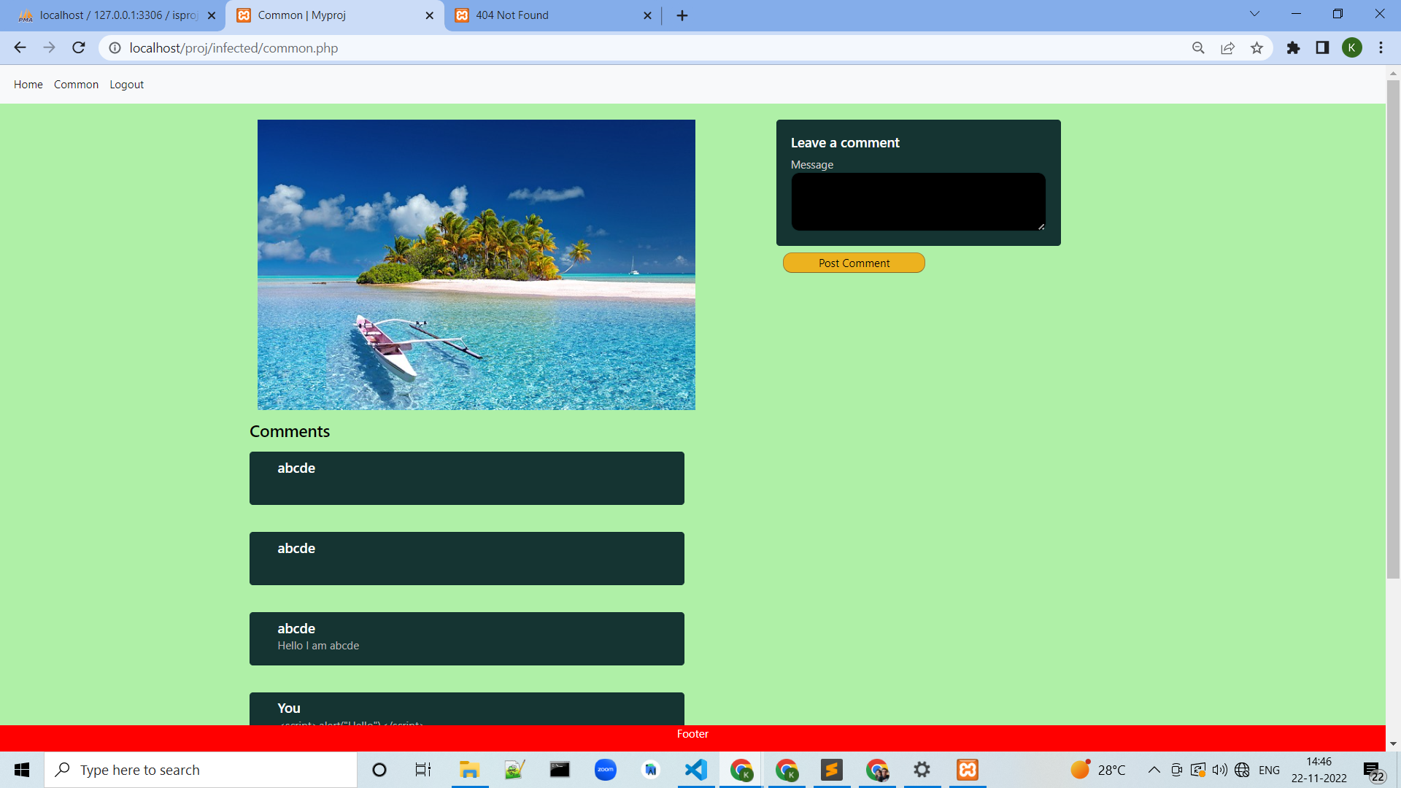
SQL Injection Attack:
View of website for malicious user.

Slide 18
SQL Injection Prevention:
Data Collection Data collected under two different conditions:
Encrypt only the password field.
Encrypt both username and password field.
The attackers cannot do anything with the above information. Without knowing the algorithm and key used it is not possible to decrypt the data. This method keeps the database more secure while comparing with the standard database

Slide 19
SQL Injection Prevention:
Adding user by encrypting the email and password to avoid the SQL injection.

Slide 20
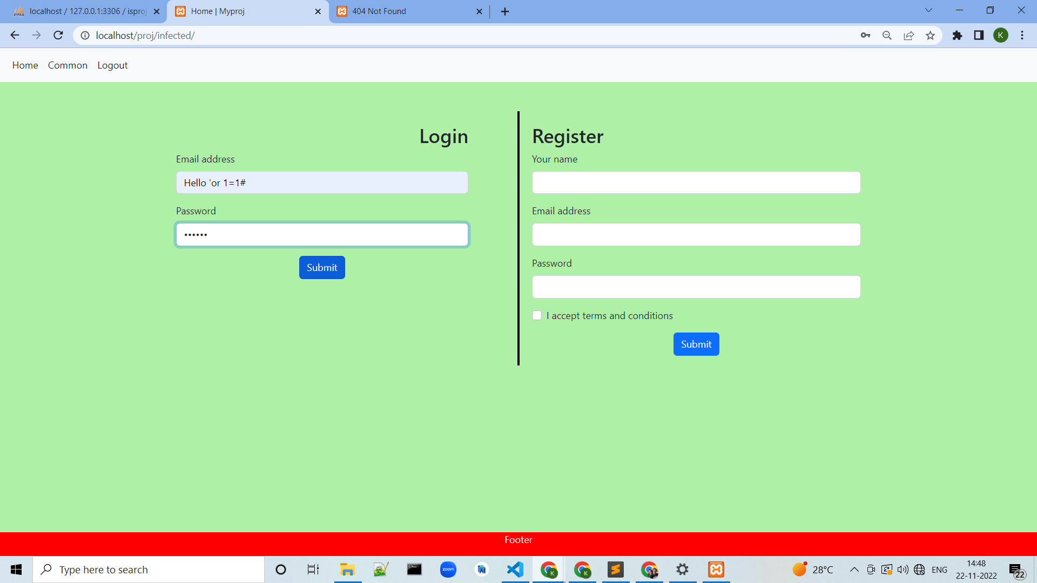
SQL Injection Prevention:
Malicious user trying to log in inside website

Slide 21

SQL Injection Prevention:
Malicious user logged in unsuccessful due to encryption.

Slide 22
Cross Site Scripting:
What is meant by cross-site scripting?
➔ Definition. Cross site scripting (XSS) is an attack in which an attacker injects malicious executable scripts into the code of a trusted application or website. Attackers often initiate an XSS attack by sending a malicious link to a user and enticing the user to click it.

Slide 23
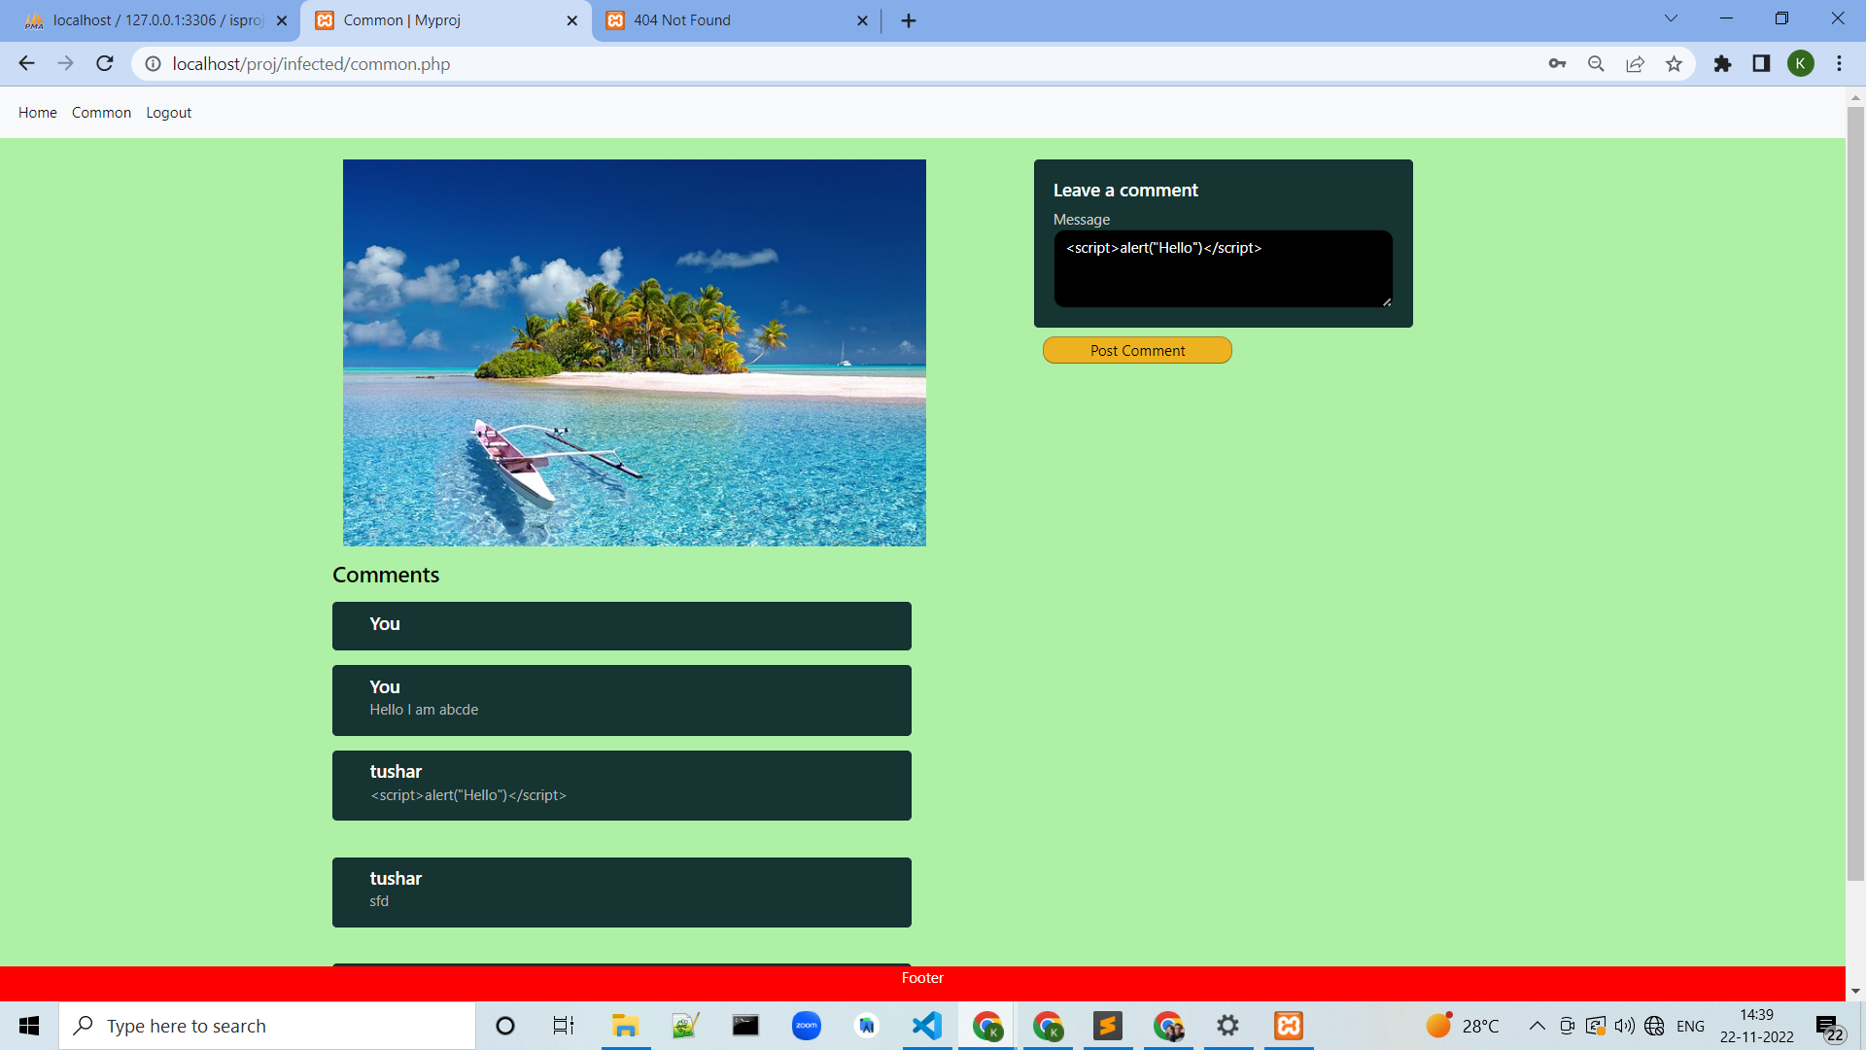
Cross Site Scripting:
Adding script as a comment to do cross site scripting

Slide 24

Cross Site Scripting:
Popup of “hello” is generated due to adding script as comment.

Slide 25
Cross Site Scripting:
Comment table after adding script.

Slide 26

Cross Site Scripting:
Adding another script as comment

Slide 27
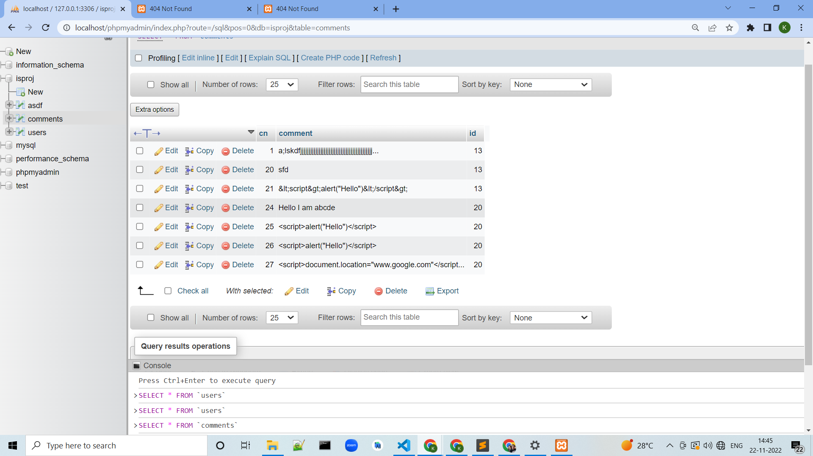
Cross Site Scripting:
Showing the comments table after inserting another script as comment.

Slide 28
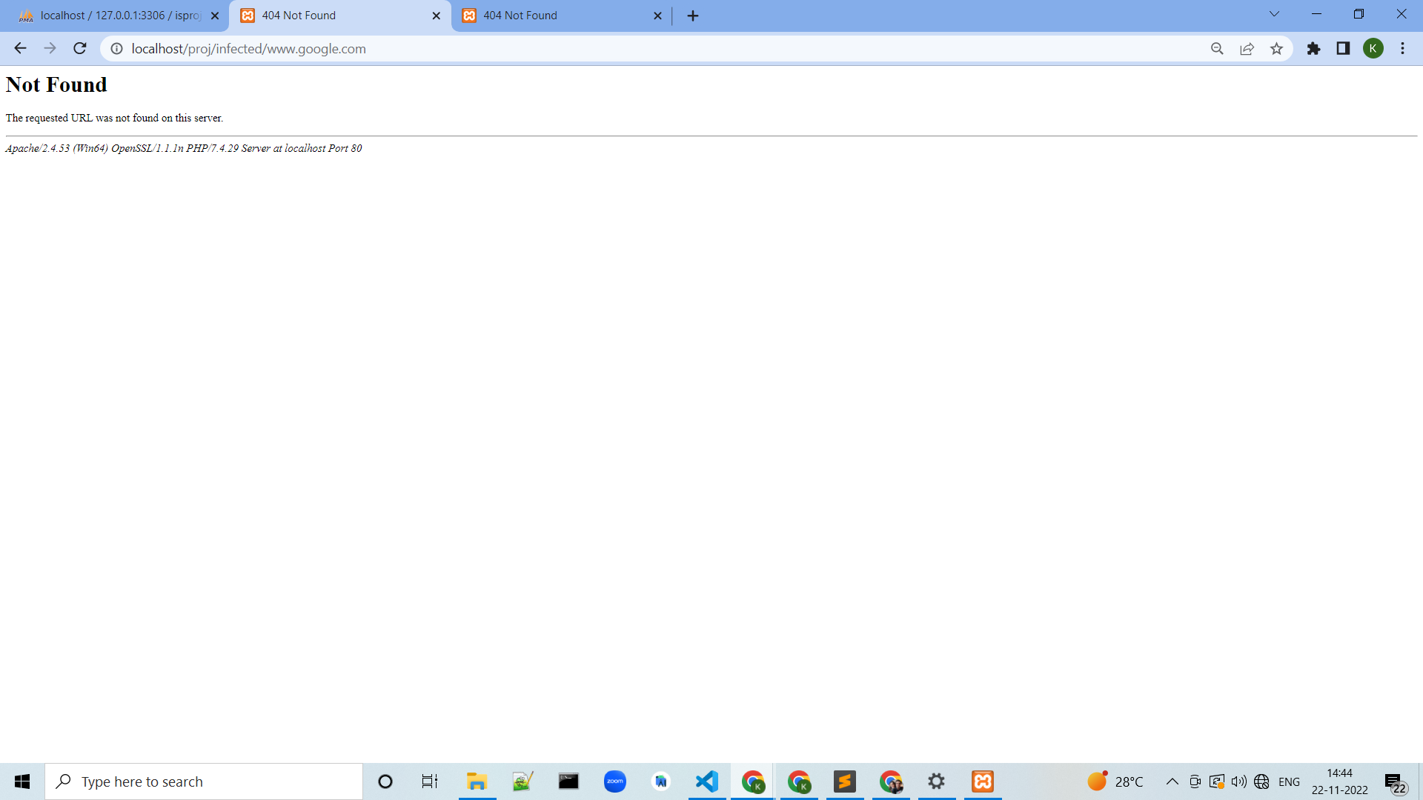
Cross Site Scripting:
Result of second script on website.

Slide 29
Cross Site Scripting Prevention:
Output Encoding:
Output Encoding is recommended when you need to safely display data exactly as a user typed it in. Variables should not be interpreted as code instead of text. This section covers each form of output encoding, where to use it, and where to avoid using dynamic variables entirely.
Start with using your framework’s default output encoding protection when you wish to display data as the user typed it in. Automatic encoding and escaping functions are built into most frameworks.
If you’re not using a framework or need to cover gaps in the framework then you should use an output encoding library. Each variable used in the user interface should be passed through an output encoding function. A list of output encoding libraries is included in the appendix.
There are many different output encoding methods because browsers parse HTML, JS, URLs, and CSS differently. Using the wrong encoding method may introduce weaknesses or harm the functionality of your application.
If you're using JavaScript for writing to HTML, look at the .textContent attribute as it is a Safe Sink and will automatically HTML Entity Encode.
& &amp;
< &lt;
> &gt;
“ &quot;
' &#x27;

Slide 30
Cross Site Scripting Prevention:
Adding script as a comment so that it will not execute as script rather it will be shown as it is.

Slide 31
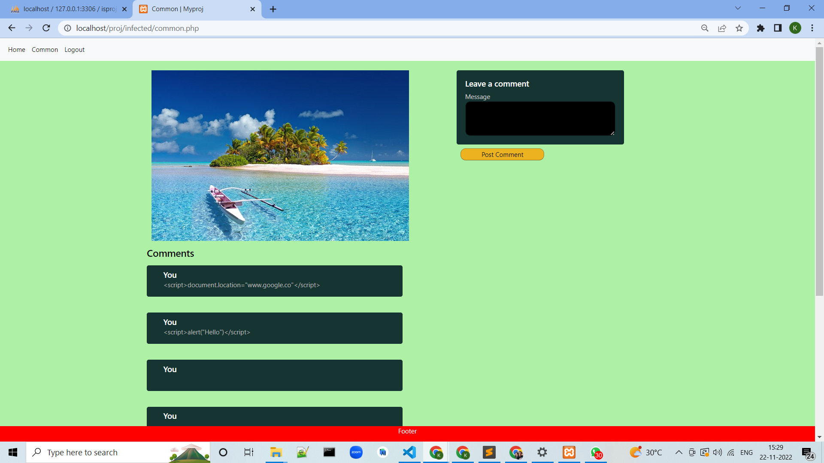
Cross Site Scripting Prevention:
Users can now see the comment of script not the popups or will not go to the location mentioned in script because of output encoding.

Slide 32
Summary:
We have created one web application which shows the comments made by users on a particular picture. Then we have performed SQL Injection attack on it and also shown how cross site scripting is done by attackers. Then we have made solutions to these 2 problems to avoid it.
Github Link for project
https://github.com/kushal262001/Preventing-SQL-injection-and-cross-site-scripting.git

Slide 33
THANK YOU!!!

